Slide 1
Advanced Ensemble Learning for Solar Panel Efficiency Prediction
Zelestra x AWS ML Ascend Challenge
Team Name: TensorV3
Members:
Vigneshwaran S
Venkat Balaji S

Slide 2
Problem Statement
Objective:
Predict solar panel efficiency based on environmental and operational parameters
Dataset Characteristics
Target Variable: Efficiency (continuous regression problem)
Features: Environmental conditions (humidity, pressure, wind_speed) and operational parameters
Data Quality Issues: Mixed data types, missing values, inconsistent formatting
Feature Engineering Opportunity: Interaction terms and polynomial features
Key Preprocessing Challenges
String-to-numeric conversion for meteorological data
Handling mixed data types (categorical and numerical)
Missing value imputation strategy
Feature scaling and normalization

Slide 3
Advanced Preprocessing Pipeline
Data Cleaning & Type Conversion
Converted meteorological features (humidity, pressure, wind speed) from text to numeric format
Handled invalid values using coercion to ensure consistency
2. Power Transformation & Scaling
Yeo-Johnson Transformation: Normalize skewed distributions
Robust Imputation: Mean strategy for missing values
Label Encoding: Categorical variables to numerical
Infinite Value Handling: Replace inf/-inf with NaN

Slide 4
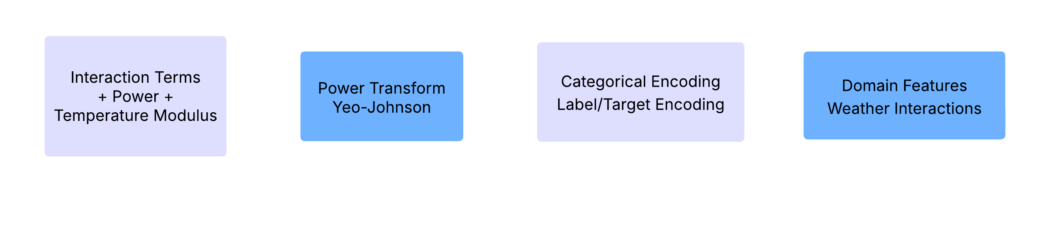
Advanced Preprocessing Pipeline
3. Feature Engineering (Model-Specific)
4. Model-Specific Preprocessing
TabNet: Imputer Categorical embeddings with dimensions [3,3,3]
H2O/AutoGluon: Automated feature engineering
Tree Models ML: Standard scaling + polynomial features
Stack Regression Models: Standard scaling + polynomial features

Slide 5
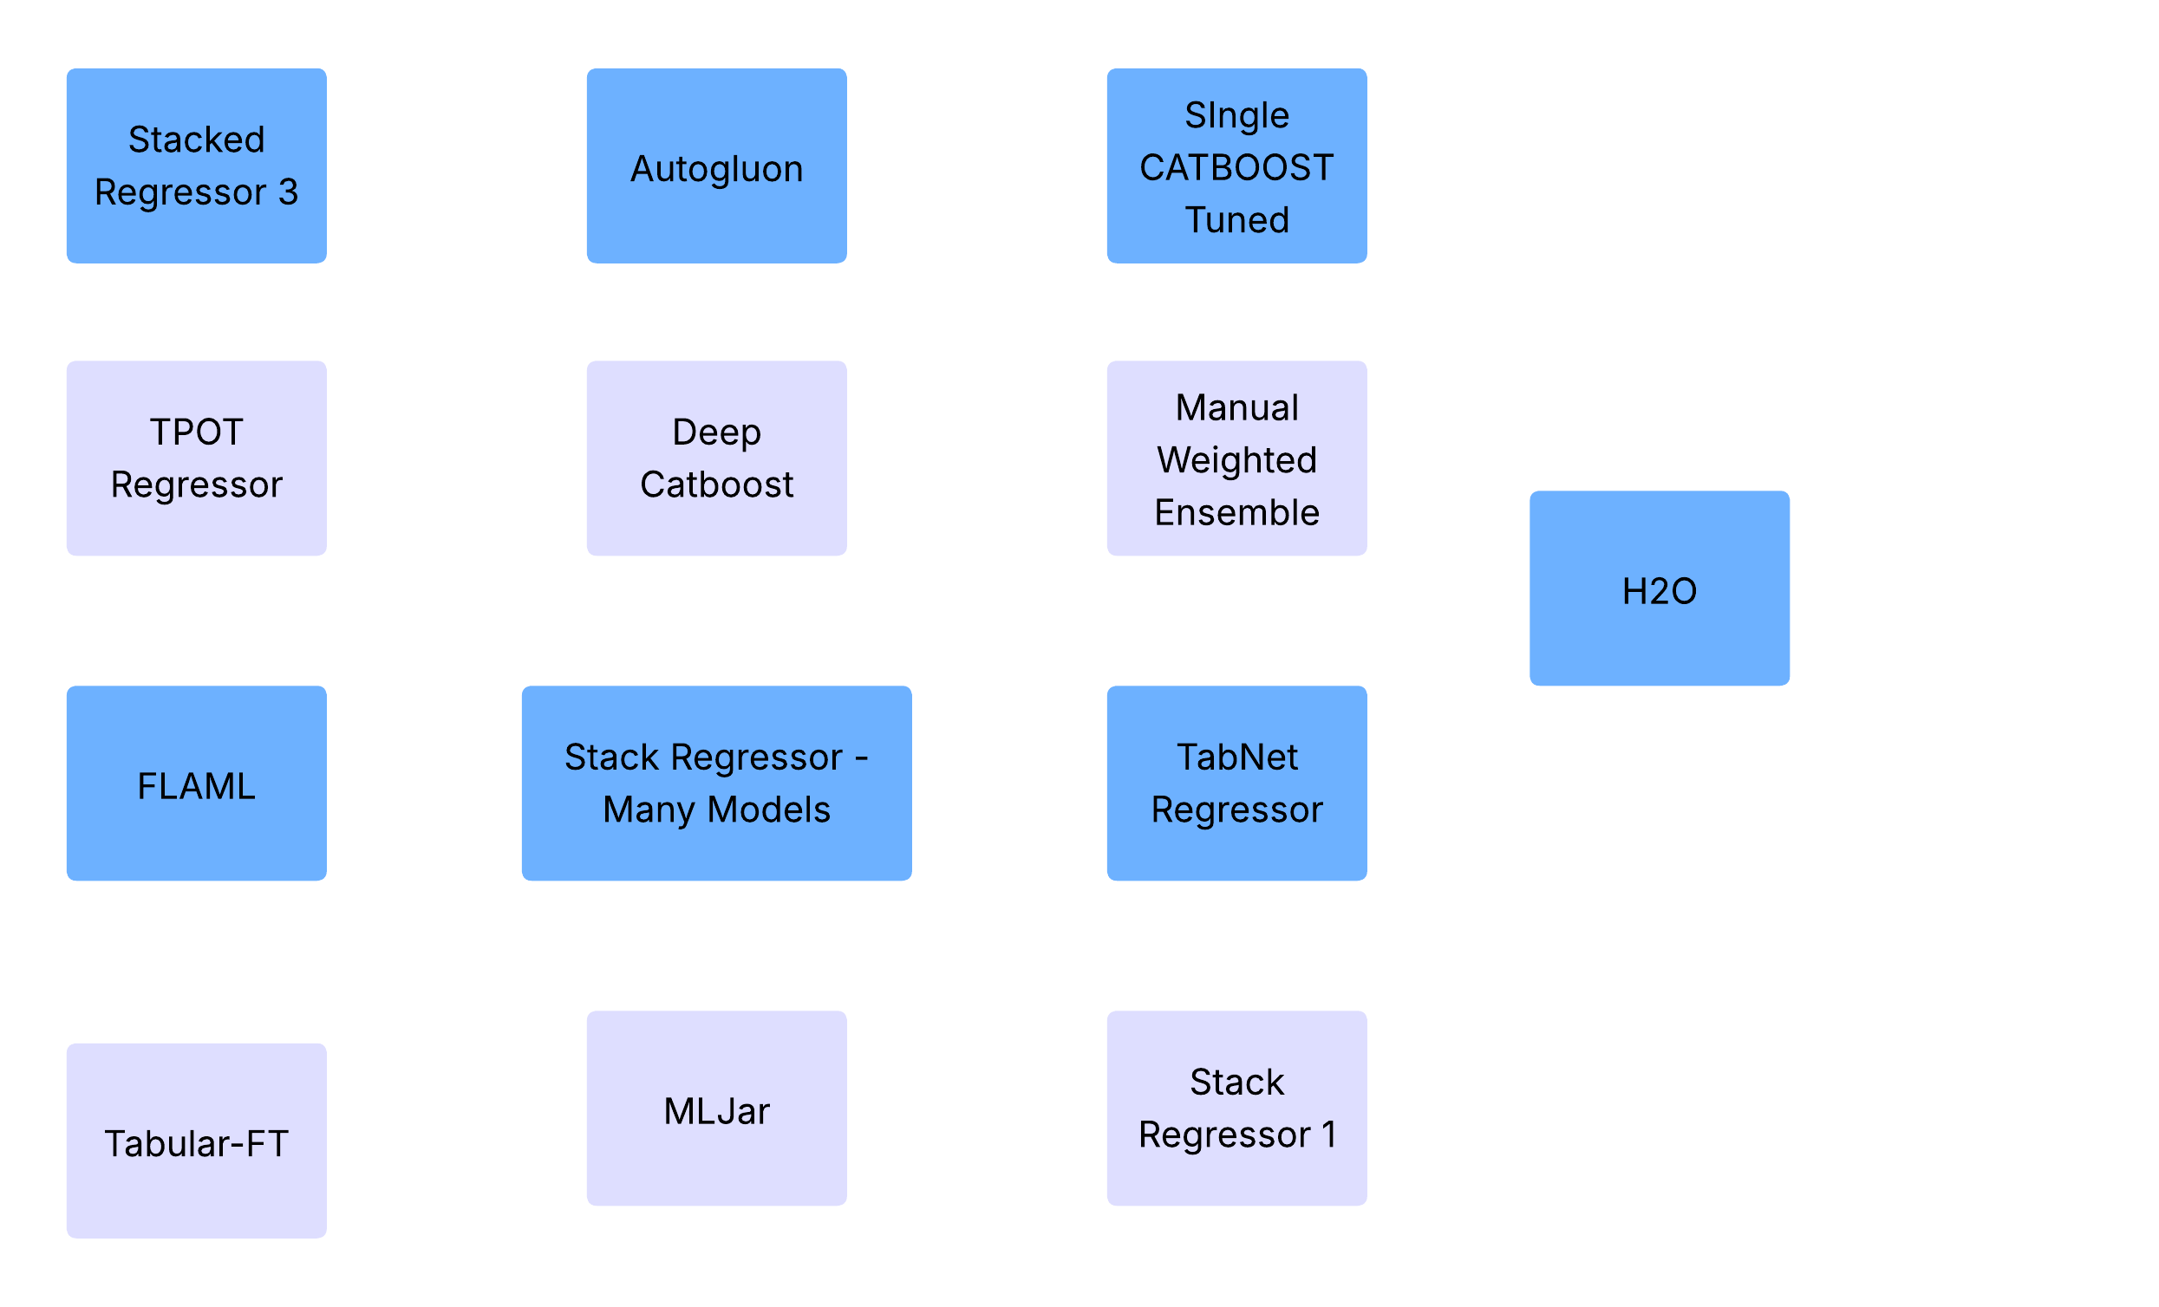
Comprehensive Model Architecture
Multi-Level Ensemble Strategy

Slide 6
Comprehensive Model Architecture
Stacked Regressor 3: An Hyperparameter tuned ensemble regressor combining Catboost, XGBoost, RandomForest, LGBM, ET using stacking to leverage their complementary strengths.
AutoGluon: A powerful AutoML framework that automates model selection, training, and ensembling for tabular datasets.
Single CatBoost Tuned: A hyperparameter tuned high-performing gradient boosting model fine-tuned for optimal accuracy on structured and categorical data.
TPOT Regressor: An AutoML tool that uses genetic programming to discover the best-performing regression pipeline.
Deep CatBoost: An enhanced version of CatBoost leveraging deeper architectures.

Slide 7
Comprehensive Model Architecture
Manual Weighted Ensemble: A custom ensemble approach that linearly combines model outputs using manually chosen weights for better predictions - Catboost, XGBoost, RandomForest, LGBM, ET.
FLAML: A fast and lightweight AutoML library that efficiently searches for accurate models under resource constraints.
Stack Regressor – Many Models: A stacked regression model combining Gradient Boosting, Random Forest, XGBoost, LightGBM, and CatBoost is used to predict efficiency. Ridge regression acts as the meta-learner to blend base model outputs for improved accuracy.
TabNet Regressor: A deep learning model that uses sequential attention to perform interpretable and efficient tabular data learning. Hyperparameter tuned using optuna.

Slide 8
Comprehensive Model Architecture
H2O: A scalable and robust AutoML platform that automatically builds and blends multiple regression models.
Stacking Regressor – FLAML : Used FLAML as Meta-Model in stacking regressor
Stacking Regressor – FLAML Advanced: Tuned FLAML
Stacking Regressor 1 - An Hyperparameter tuned ensemble regressor combining Catboost, XGBoost, RandomForest, LGBM, ET using stacking to leverage their complementary strengths.
MLJar - The MLjar-AutoML is an Automated Machine Learning Python package that works with tabular data.
Tab FTTransformer – A hyperparameter tuned Transformer based Tabular ML Model

Slide 9
Advanced Multi-Level Ensemble Architecture
Manual Weighted Ensemble Breakdown
Model Name | Individual LB Score | Weight
H2O | 89.89176 | 0.65
Manual Ensemble Weighted | 89.86597 | 0.50
TabNet | 89.88160 | 0.40
Stack Regressor 1 | 89.87982 | 0.40
AutoGluon | 89.84440 | 0.30
Deep CatBoost | 89.84000 | 0.35
MLJAR | 89.88173 | 0.10

Slide 10
Advanced Multi-Level Ensemble Architecture
Manual Weighted Ensemble Breakdown
Model Name | Individual LB Score | Weight
Stack Regressor – Many Models | 89.85290 | -0.20
Stack Regressor 3 | 89.87988 | -0.10
TPOT | 89.83612 | -0.20
FLAML | 89.84897 | -0.10
Tabular-FTTransformer | 89.76028 | -0.20
Single CatBoost (Tuned) | 89.84074 | -0.35
Stacking Regressor – FLAML Advanced | 89.85412 | 0.1
Stacking Regressor – FLAML | 89.84103 | -0.1

Slide 11
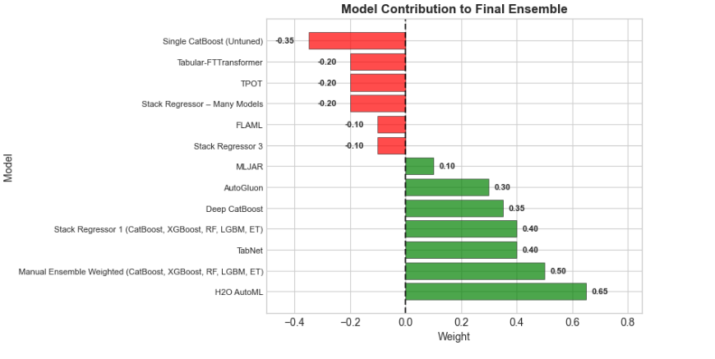
Model Diversity and Ensemble Strategy
Ensemble Innovation: Negative Weighting
Diversity Enhancement: Negative weights prevent overfitting
Bias Correction: Counteract systematic errors
Performance Boost: Improved generalization through contrast
Risk Management: Reduced ensemble variance

